Slide 2
explore and learn the concepts of Shuffle and Sort

Slide 3
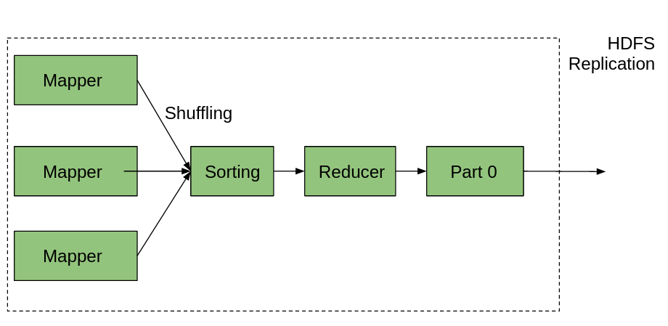
Introduction

Slide 4
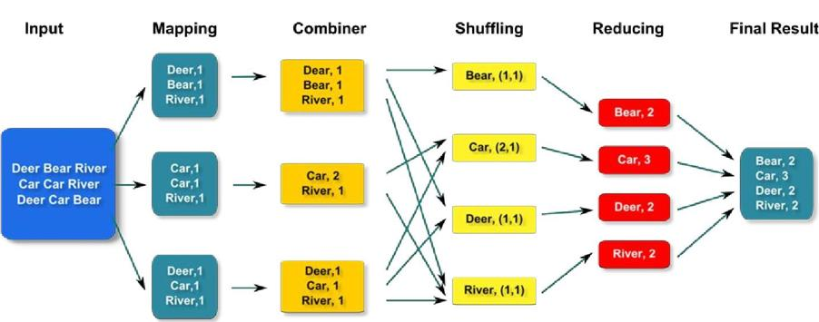
Introduction

Slide 5
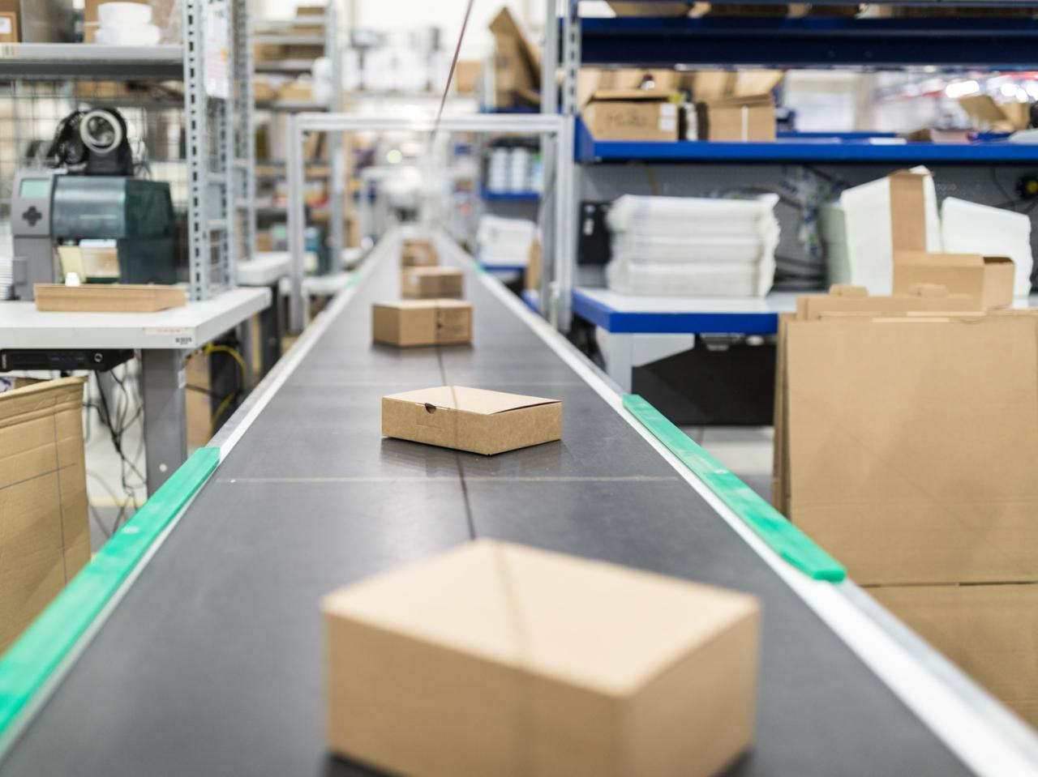
What is Shuffling and Sorting in Hadoop MapReduce?

Slide 6
Phases of MapReduce
Mapper
Reducer in MapReduce
Combiner
Partitioner in MapReduce
inputFormat
in MapReduce

Slide 7
Shuffle and Sort
INPUT

Slide 8
Shuffle and Sort
Map Task
MAP
INPUT

Slide 9
Shuffle and Sort
Partition,sort and Spill on local disk
Map Task
In memory buffer
MAP
INPUT

Slide 10
Shuffle and Sort
Partition,sort and Spill on local disk
Map Task
In memory buffer
MAP
INPUT
io.sort.mb
100Mb(default)

Slide 11
Shuffle and Sort
Partition,sort and Spill on local disk
Map Task
In memory buffer
MAP
INPUT
80%
io.sort.spill.percent
io.sort.mb
100Mb(default)

Slide 12
Shuffle and Sort
Partition,sort and Spill on local disk
Map Task
In memory buffer
MAP
INPUT
80%
io.sort.spill.percent
io.sort.mb
100Mb(default)

Slide 13
Shuffle and Sort
Partition,sort and Spill on local disk
Map Task
In memory buffer
MAP
INPUT
80%
io.sort.spill.percent
io.sort.mb
100Mb(default)

Slide 14
Shuffle and Sort
Partition,sort and Spill on local disk
Map Task
In memory buffer
MAP
INPUT
80%
io.sort.spill.percent
Partitions
io.sort.mb
100Mb(default)
mapred.local.dir

Slide 15
Shuffle and Sort
Partition,sort and Spill on local disk
Copy Phase
Map Task
In memory buffer
MAP
INPUT
Merge on disk
80%
io.sort.spill.percent
Partitions
io.sort.mb
100Mb(default)
mapred.local.dir

Slide 16
Shuffle and Sort
mapred.compress.map.output
mapred.map.output.compression.codec
Map Task
Partition,sort and Spill on local dis
In memory buffer
MAP
INPUT
80%
io.sort.spill.percent
Partitions
io.sort.mb
100Mb(default)
mapred.local.dir

Slide 17
Shuffle and Sort
Partition,sort and Spill on local disk
Copy Phase
In memory buffer
MAP
INPUT
80%
io.sort.spill.percent
io.sort.mb
100Mb(default)
Partitions
mapred.local.dir
-------------------------------------------------------------------------------
-------------------------------------------------------------------------------

Slide 18
Shuffle and Sort
Sort Phase
Partitions are copied by the reducer from the network
Copy Phase
------------------------------------
-----------------------------------

Slide 19
Shuffle and Sort
Sort Phase
Partitions are copied by the reducer from the network
Copy Phase
------------------------------------
-----------------------------------

Slide 20
Shuffle and Sort
Sort Phase
Partitions are copied by the reducer from the network
Copy Phase
------------------------------------
-----------------------------------

Slide 21
Shuffle and Sort
Sort Phase
Reduce Phase
Partitions are copied by the reducer from the network
Reduce
Result
Merged File
Copy Phase
Reduce
Result
Merged File
Reduce
Result
Merged File
------------------------------------
Mixture of in-memory and on-disk data
-----------------------------------

Slide 22
Shuffle and Sort
Merge factor => io.sort.factor
Its default value is 10

Slide 23
Shuffle and Sort
30 Files

Slide 24
Shuffle and Sort
30 Files
10
10
10

Slide 25
Shuffle and Sort
30 Files
10
10
10
Merged File
Merged File
Merged File

Slide 26
Shuffle and Sort
30 Files
10
10
10
Merged File
Reduce
Merged File
Merged File

Slide 27
Shuffle and Sort
30 Files
3
10
10
6(left)
Merged File
Merged File
Merged File

Slide 28
Shuffle and Sort
30 Files
3
10
10
6(left)
Merged File
Reduce
Merged File
Merged File

Slide 29
Shuffle and Sort
Objective
Intermediate output from mappers is transferred to the reducer is called Shuffling.
Intermediated key-value generated by mapper is sorted automatically by key.

Slide 30
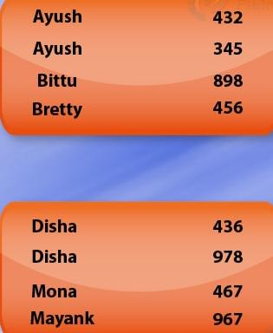
Shuffle and Sort
Ayush 432
Mona 467
Bittu 898
Disha 436
Disha 898
Ayush 345
Bretty 456
Mayank 967
Shuffling and Sorting in Hadoop MapReduce

Slide 31
Shuffle and Sort
Shuffle phase.
Sort phase
Data from the mapper are grouped by the key, split among reducers and sorted by the key.
All values associated with the same key.
Shuffle and sort phase in Hadoop occur simultaneously and are done by the MapReduce framework.

Slide 32

Shuffle and Sort
Shuffling in MapReduce

Slide 33

Shuffle and Sort
Sorting in MapReduce

Slide 34

Shuffle and Sort
Secondary Sorting in MapReduce

